Slide 1
Final Engagement
Attack, Defense & Analysis of a Vulnerable Network

Slide 2
Table of Contents
This document contains the following resources:
Network Topology & Critical Vulnerabilities
Exploits Used
Methods Used to Avoiding Detect

Slide 3

Network Topology
& Critical Vulnerabilities
3

Slide 4
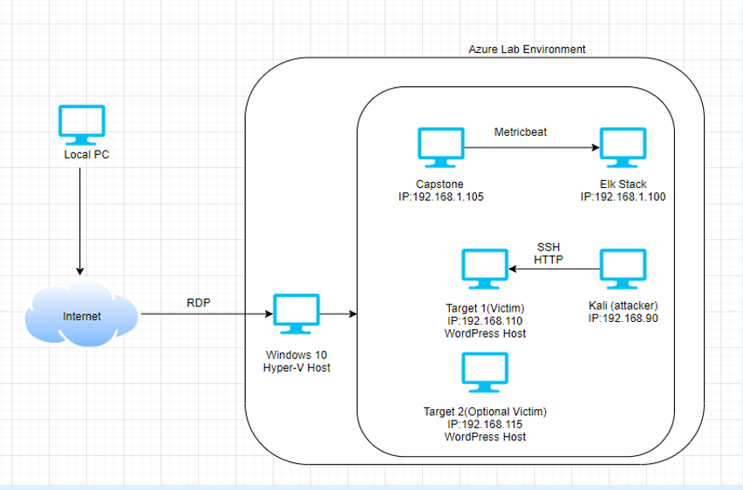
Network Topology
Network
Address Range: 192.168.1.0/24
Netmask: 255.255.255.0
Gateway: 192.168.1.1
Machines
IPv4: 192.168.1.90
OS: Linux 2.6.32
Hostname: Kali
IPv4: 192.168.1.105
OS: Linux
Hostname: Capstone
IPv4: 192.168.1.110
OS: Linux
Hostname: Target1
IPv4: 192.168.1.115
OS: Linux
Hostname: Target2
IPv4: 192.168.100
OS: Linux
Hostname: ELK
[Insert Here]
Use draw.io to create a diagram of the network.
Add your diagram to this slide and fill out the data in the sidebar.

Slide 5
Critical Vulnerabilities: Target 1
Our assessment uncovered the following critical vulnerabilities in Target 1.
Vulnerability | Description | Impact
BruteForce Vulnerability | Passwords did not require complex characters/symbols nor did they set time resets to prevent brute force. | Allowed users to keep the same password for as long as they wanted to, makes bruteforce more likely to be successful.
Sensitive Data Exposure | MySQL Login information being accessible through a non-admin/common account. | Gave anyone logged into user “Michael” access to MySQL.
Security Misconfiguration | Misconfiguration of unprotected files/directories, default credentials. | Allowing unprivileged user access to files they shouldn’t have access. For eg. “wp-config.php” can be very harmful if it leaks to the wrong person.
User Enumeration (WordPress) | Enumeration of Wordpress | This exposes the critical information like users authorised for wordpress and an attacker can further bruteforce that user to access wordpress

Slide 6
Exploits Used
6

Slide 7
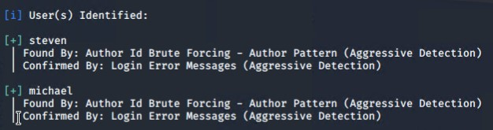
Exploitation: User Enumeration (WordPress)
We exploited the WordPress permalinks feature with WPScan.
Using WPScan for user enumeration we were able to gain the usernames “Michael” and “Steven”.

Slide 8
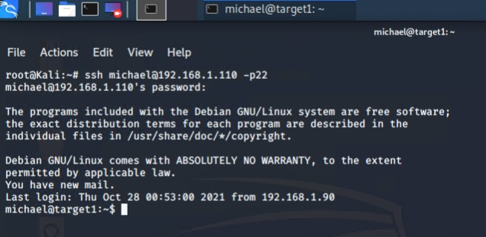
Exploitation: Open SSH (Port 22) and Weak Password
Simply by guessing Michael’s password was easy enough, though a tool such as ‘Hydra’ would have easily cracked the password in no time, unfortunately this would be much easier to detect.
This allowed us to gain access to Michaels account on the target machine (192.168.1.110)

Slide 9
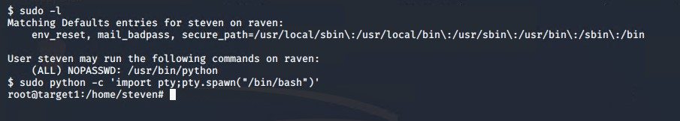
Exploitation: Privilege Escalation
After gaining Steven’s credentials through MySQL, we were able gain access to his account. Looking into Steven’s privileges we saw that he is able run python commands with no password.
Using this python exploit we were able to gain root access and find flag 4.

Slide 10
Avoiding Detection
10

Slide 11
Stealth Exploitation of Scanning Open Ports of Target (nmap)
Monitoring Overview
The alert “HTTP Request Size Monitor” was triggered.
This measures the amount of requests received by the target.
The threshold for this is 3500 requests per minute.
Mitigating Detection
Setting the Timing Template (-T) and -sS options using nmap.
While there are many comparable alternatives, nmap is the best choice unless scanning a machine with very strict alerts with low thresholds.

Slide 12

Stealth Exploitation of Directory Enumeration (dirbuster)
Monitoring Overview
The alerts “Excessive HTTP Errors” and “HTTP Request Size Monitor” were triggered.
“Excessive HTTP Errors” measures the amount of returned HTTP response codes for the top 5 most returned codes over 5 mins. “HTTP Request Size Monitor” measure the number of requests sent to the target per minute.
“Excessive HTTP Errors” fires at 400 response codes every 5 mins and “HTTP Request Size Monitor” fires at 3500 requests per minute.
Mitigating Detection
Setting a delay (-z) between each tested directory/file and using a smaller wordlist.
An alternative would be to guess the directory paths in a browser, however even though this is less aggressive, it is also a lot more time consuming.

Slide 13
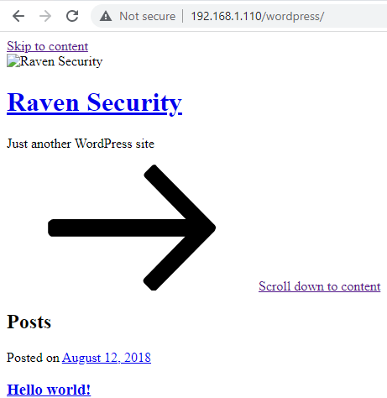
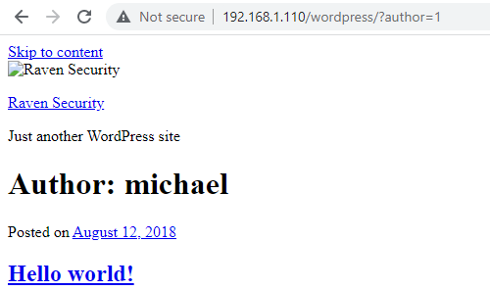
Stealth Exploitation of WordPress User Enumeration (wpscan)
Monitoring Overview
Excessive HTTP Errors” alert would detect this.
This measures the amount of returned HTTP response codes for the top 5 most returned codes.
400 is the threshold for this alert
Mitigating Detection
Using a less aggressive setting for the enumeration (less packets over time).
Manual enumeration using author query in URL.

